Slide 1
Factorial Designs
Chapter 11

Slide 2
Factorial designs
Allow experiments to have more than one independent variable.

Slide 3
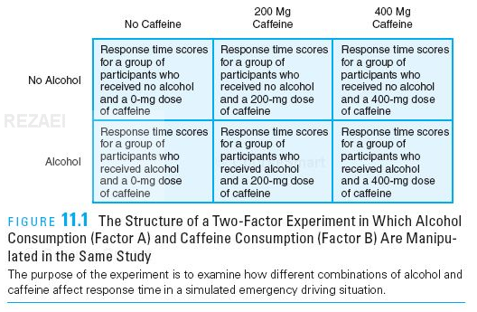
Example

Slide 4
Example
This example has two levels for the alcohol factor ( factor A) and three levels for the caffeine factor ( factor B), and can be described as a 2X3 ( read as “ two by three”) factorial design
The total number of treatment conditions can be determined by multiplying the levels for each factor.

Slide 5
Main effect
The mean differences among the levels of one factor are called the main effect of that factor.

Slide 6
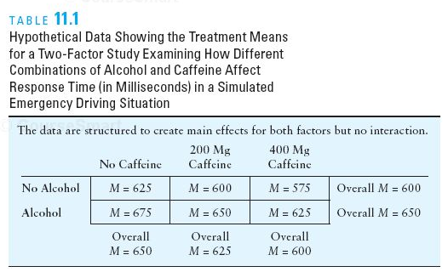

Slide 7
Interaction
An interaction between factors ( or simply an interaction) occurs whenever two factors, acting together, produce mean differences that are not explained by the main effects of the two factors.

Slide 8
Example 1- Main effect only
+25
+25
+50
+50
+50
+25
+25

Slide 9
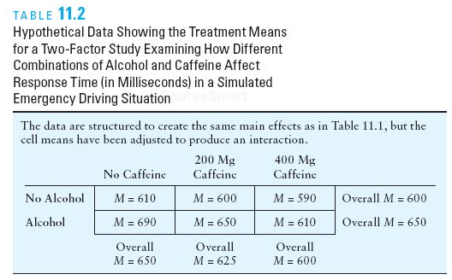
Example 2 - Interaction
+10
+10
+80
+50
+20
+40
+40

Slide 10
Alternative Definitions of an Interaction
When the effects of one factor depend on the different levels of a second factor, then there is an interaction between the factors.
A second alternative definition of an interaction focuses on the pattern that is produced when the means from a two- factor study are presented in a graph.

Slide 11
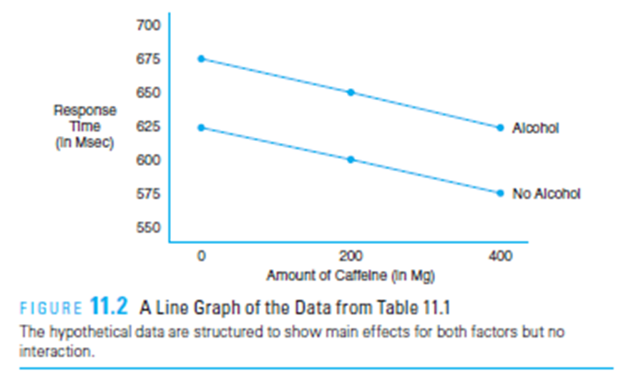
When the results of a two- factor study are graphed, the existence of nonparallel lines ( lines that cross or converge) is an indication of an interaction between the two factors. ( Note that a statistical test is needed to determine whether the interaction is significant.)

Slide 12
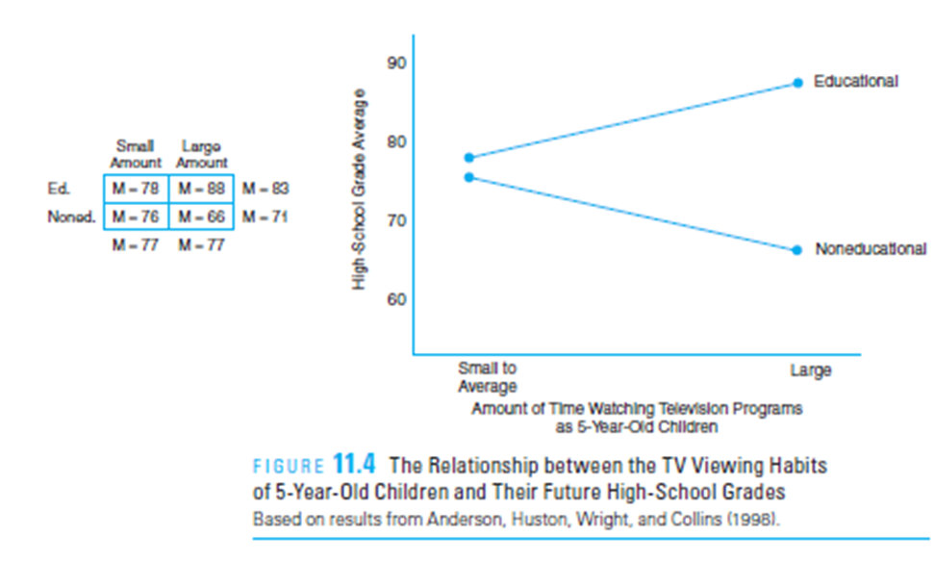
Interaction
≠
=

Slide 13
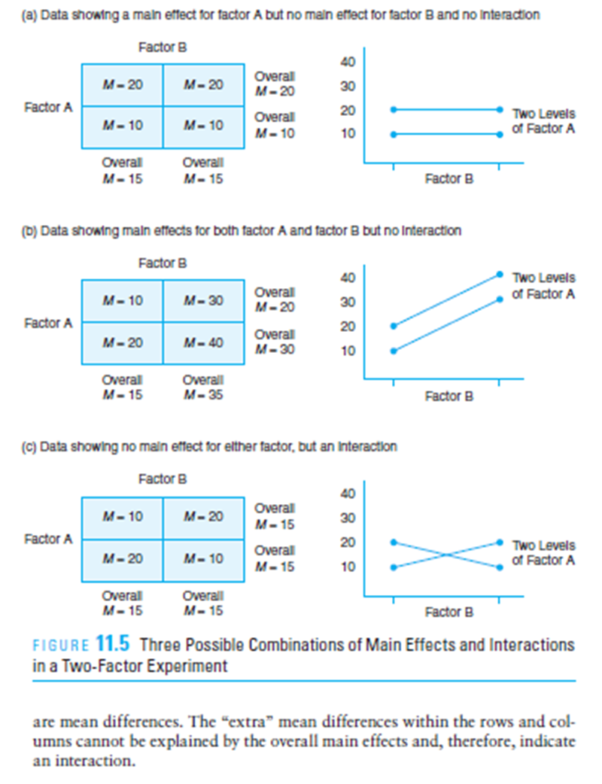
sample Possible outcomes
Main effect Factor A
Not B
Main effect for A & B
No main effect
Interaction A&B

Slide 14
Types of Mixed Designs
A factorial study that combines two different research designs is called a mixed design.
Both Experimental – Both between
Both Experimental –Both Within
Both Experimental - One between- subjects factor and one within- subjects factor.
Both factors are non-manipulated (pre existing)
One experimental & one non-experimental

Slide 15
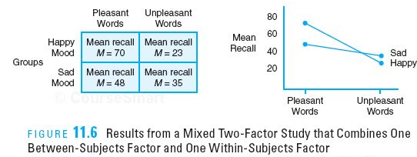
Example (between/Within)
The graph shows the pattern of results obtained by Clark and Teasdale ( 1985). The researchers showed participants a list containing a mixture of pleasant and unpleasant words to create a within- subjects factor ( pleasant/ unpleasant). The researchers manipulated mood by dividing the participants into two groups and having one group listen to happy music and the other group listen to sad music, creating a between- subjects factor ( happy/ sad). Finally, the researchers tested memory for each type of word.

Slide 16
Quasi- independent variables
It also is possible to construct a factorial study for which all the factors are non-manipulated, quasi- independent variables.

Slide 17
Higher- Order Factorial Designs
The basic concepts of a two- factor research design can be extended to more complex designs involving three or more factors; such designs are referred to as higher- order factorial designs. A three- factor design, for example, might look at academic performance scores for two different teaching methods ( factor A), for boys versus girls ( factor B), and for first- grade versus second- grade classes ( factor C).

Slide 18
Group Discussion
Explain what it means to say that main effects and interactions are all independent.
Describe how a second factor can be used to reduce the variance in a between-subjects experiment.

